Slide 1















Make your Cloud Applications Function for real – A Complete Overview of Oracle Functions as a Service
Streaming
synchronous
NoSQL Database
API Gateway
Object Storage
asynchronous
Function
Autonomous Database
Notifications
Email Delivery
Autonomous JSON
Logging
Monitoring
Auditing
Vault
Oracle Groundbreakers Tour 2020 EMEA, 13th October
Lucas Jellema, CTO & Architect AMIS | Conclusion
Sources and slides: http://bit.ly/function-for-real-ogbemea2020
Notes:
Pitch: Functions are what make cloud native applications tick. They execute business logic, handle requests and events, stitch together managed PaaS Services and automate Ops activities. In 45 minutes, get a complete overview of serverless Oracle Functions on OCI; how to develop, test, deploy, invoke and operate them
Abstract: Functions are what make cloud native applications tick. They execute business logic, handle requests and events, stitch together managed PaaS Services and automate Ops activities. Functions allow and actually strongly suggest a clean application design with decoupled, encapsulated, independently testable, scalable and evolvable mini-applications that are suitable for highly automated operations.
Oracle Functions - based on Project Fn - are at the heart of cloud native applications on Oracle Cloud Infrastructure. They are implemented in almost any programming language and are run on a virtually serverless platform. This session provides a complete overview of Oracle Functions, including several live demonstrations. You will see local development of Functions in several languages, learn about automated testing of Functions and about deployment to the OCI tenancy (from CLI, Terraform and Pipeline). Functions can be invoked in several ways: direct call, through API Gateway request, triggered by Notifications and Cloud Events and indirectly time scheduled; these are discussed and shown. Functions are configured with runtime settings, can read secrets (such as credentials and connection details) from the Vault service and can make use of other OCI Services, for example for persisting data (Autonomous Database, MySQL, NoSQL Database, Autonomous JSON), publishing messages to a stream, read or write a file or invoke another function, synchronously or asynchronously. The OCI Logging and Monitoring Services are demonstrated to support *Ops* on the Functions.
In 45 minutes, get a complete overview of serverless Oracle Functions on OCI; see how to develop, test, deploy, invoke and operate them. And embrace them as the essential cogs in your Oracle Cloud machinery.
Notes: This session touches upon a substantial number of OCI services - all from the perspective of the Functions service. All interaction points between Functions and the OCI portfolio are discussed. Implementation of Functions is demonstrated - as well as test/deployment/invocation (and effects) and monitoring.
I have worked with Project Fn and Oracle Functions from the first time it became available. I have published many articles, Katacoda scenarios and webinars on the subject. I discuss Functions both from the perspective of an architect as well as a developer.

Slide 2





Lucas Jellema CTO for AMIS | Conclusion Cloud Solution Architect
lucas.jellema@amis.nl | technology.amis.nl | @lucasjellema | lucas-jellema

Slide 3
A traditional application
UI
API
WebApp
Platform & Language runtime features (transaction management, HTTP request handling, state management & in memory caching, IAM, …
3rd party libraries & frameworks
Monolith, Microservice, Module
Custom Code
Database (RDBMS?)
Java EE
JVM
Operating System
Hardware

Slide 4
Cloud Native Application
Cache
CDN & WAF
API Gateway
Function
SaaS
Event Hub
Web App
Function
Container Engine
Managed
Quick Provision & Decommission
Distributed
Automated
Pay per use/TCO
Vendor takes runtime responsibility
Enterprise grade platform accessible to startups
Rapid Innovation
Security & Availability
Scale
Vault
Mail
IAM
PaaS
Monitor
Alert & Notify
Scaling
Logging
IaaS
Notes:
Out of the box PaaS services and facilities
persistence, routing/throttling/buffer/queue/retry
IDM, key mgt, encryption/decryption
Distribution, CDN, regional failover
Monitor, log, alert/notification
Scalability (up & down)
Quick Rampup
Emphasis on interaction points: APIs, Events/ message format
Less emphasis on implementation of PaaS (platform) services
MongoDB API – implemented by Azure Cosmos DB, MongoDB, Minimongo and AWS Document DB and soon Oracle Autonomous JSON
Kafka API – Azure Event Hub, OCI Streaming, AWS Managed Streaming
JDBC/SQL – Relational Database (Oracle, SQL Server, PostgreSQL, MySQL) and even NoSQL (Oracle NoSQL, Cassandra, Hadoop)

Slide 5
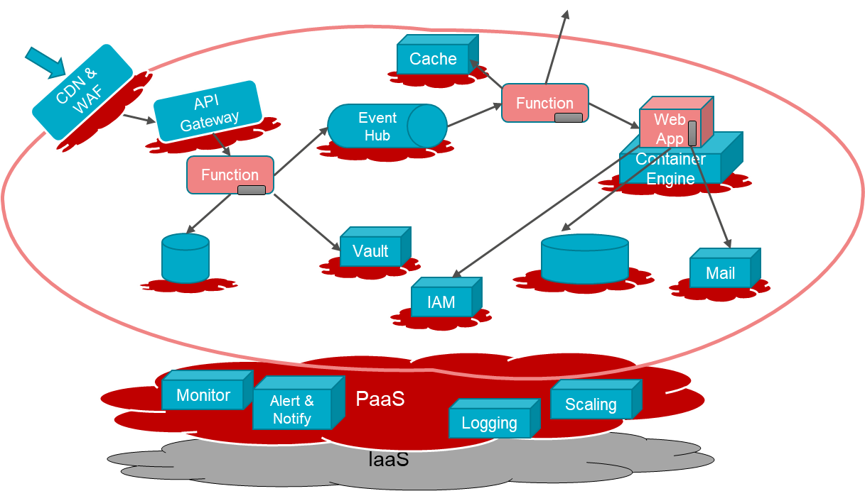
Characteristics of Cloud Native Applications
Modern – born in the cloud (era)
Emphasis on interaction (and decoupling) points:
Between custom components: APIs, Events / message format
From custom to PaaS Services: Service APIs, Formats and Protocols
Less emphasis on [and insulation from?] implementation of PaaS (platform) services
Key are industry standard APIs that are implemented by many different services
Custom code in small, simple units
No explicit Infrastructure (serverless, software defined) & managed Platform components
Stateless and Dynamically Scalable (Elastic) – expand and contract
Pay per Use
Automation – no hands on ACC and Production (speed, repeatability, dynamic adjustment)
Infrastructure/Platform as Code & Application CI/CD [pipelines]
Functions

Slide 6


What are Functions?
(typically small) Stateless Execution Engines that handle one request or event
They can do anything regular applications can do – as long as they can do it in limited time (a few minutes max, ideally even shorter)
Serverless: functions are deployed and executed in an abstract, fully managed environment that automatically scales up and down (FaaS)
DevOps teams do not need | get to configure VMs, servers, network
Pay per execution – and per duration, memory and CPU
Glue and worker bees in cloud environments
For both application functionality and Ops-automation

Slide 7
Function Implementation
Implemented in any programming language –
frequently JavaScript/Node, C#, Python, Go and Java; also shell, binary executable
Frequently backed (visibly or implicitly) by Docker Containers
Parametrized via Configuration Settings
Leverage Cloud facilities
Logging
Monitoring
Auditing
Authorization
IaaS: Compute, Network, Storage
Container Orchestration, Container Image Registry

Slide 8


Introducing Serverless Functions
The Container Native Serverless Framework
Project Fn is an open source FaaS platform that you can run anywhere -- any cloud or on-premise.
It implements serverless Functions through Docker containers
Out of the box support for many runtimes
also support for custom Docker Container (white box)
Command Line Interface
create, develop, deploy, invoke, inspect

Slide 9

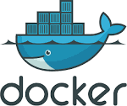
Fn Functions – request handling
HTTP method, headers, query parameters, url path, body
Function as a Service framework
FDK
HTTP Request
Function Implementation (Node, Java, Go, Python, custom Docker, …)
input – derived from body
ctx – raw HTTP request components

Slide 10

Quick Demo of Oracle Functions
Create new Function (in existing App) locally
Implement special hello world
Deploy Function App locally
Invoke Function App locally
Through CLI

Slide 11


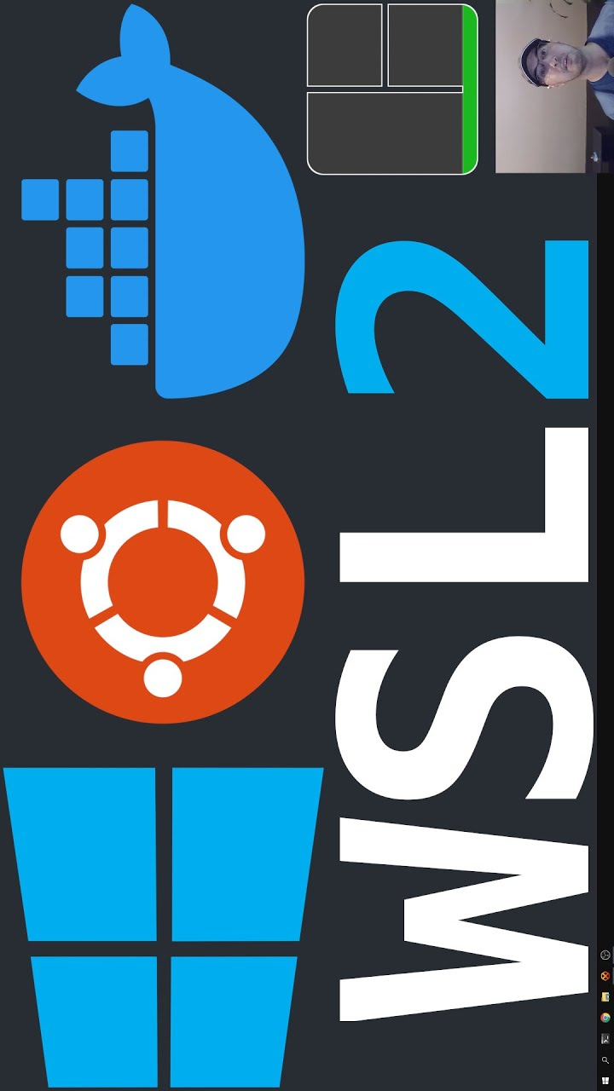
Demo Your First Function – local Fn environment
1
fn start
3
4
fn init --runtime node hello
<edit
function hello>
2
fn create app hello-app
Function hello
5
fn deploy -app hello-app --local
Fn server
Application hello-app
6
fn invoke hello-app hello
Fn server
Function hello
hello
http request
Docker
Local Docker Container Image Registry
hello

Slide 12
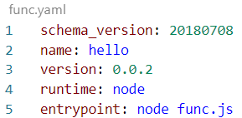
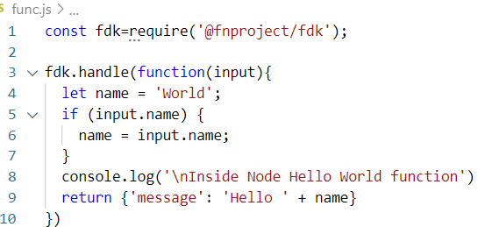
Generated Function in Node
meta-data for Fn SDK runtime
Implementation of the function

Slide 13
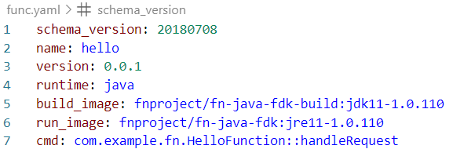

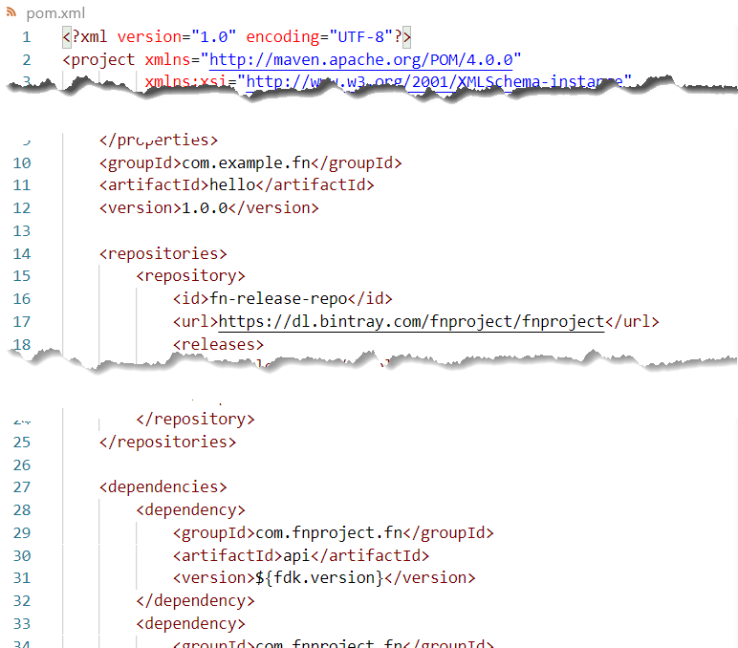
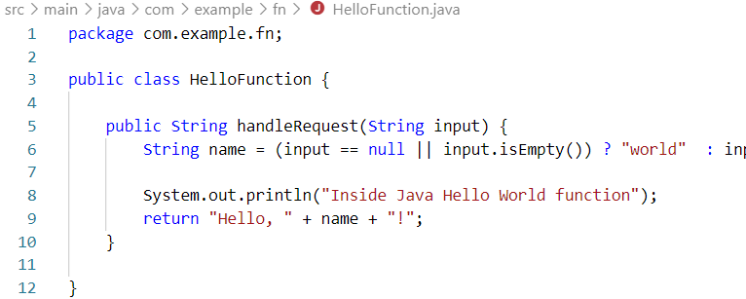
Generated Function in Java
meta-data for Fn SDK runtime
Implementation of the function
Maven pom.xml with Fn dependencies

Slide 14
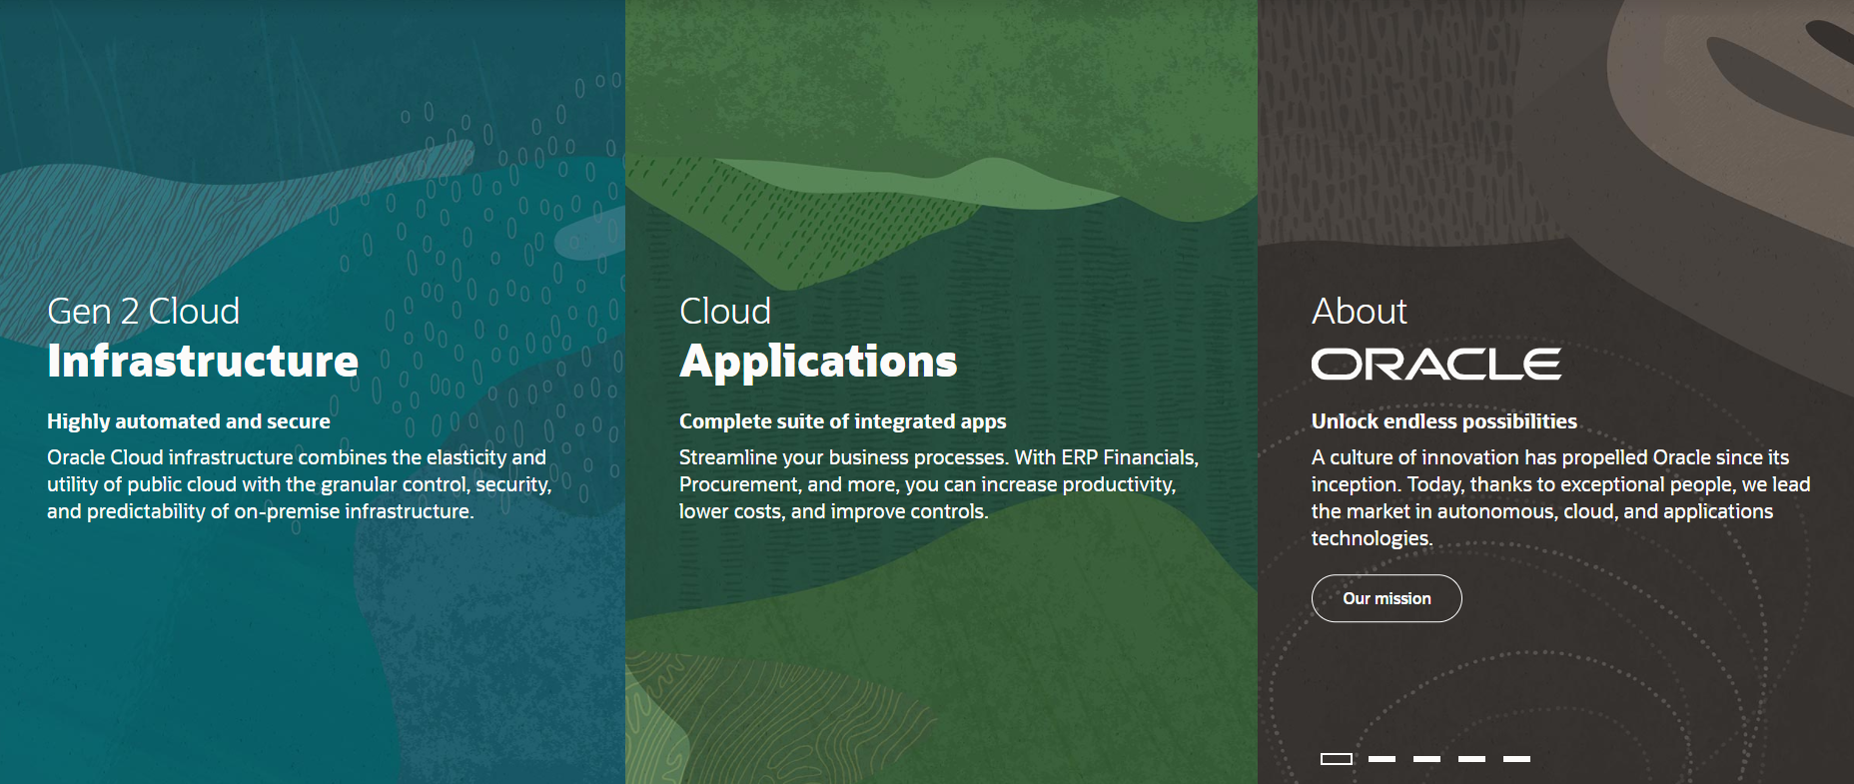
Introducing Oracle Cloud Infrastructure
IaaS & PaaS

Slide 15

Oracle Cloud Infrastructure
Generation 2 Cloud
Main themes:
Competitive Pricing
Secure by Design
Open
Enterprise (Technology)
Trials – 30 days, $300 credits
An always-free tier
With Autonomous Database and Autonomous Data Warehouse

Slide 16
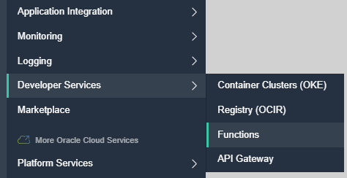
Oracle Functions
Functions on OCI – based on Fn
FaaS (Project Fn)
Interacts with container platform – run | scale | watch | …
Is a generic open source framework that can run anywhere on Docker
Handles request – load balance, route, provide context
Manages application configuration settings
Function Container Images are stored in OCI Container (Image) Registry
Triggers are HTTP Requests or OCI Events
OCI gathers logs and metrics

Slide 17
Quick Demo of Oracle Functions
Create new Function (in existing App) locally
Implement special hello world
Deploy Function App locally
Invoke Function App locally
Through CLI
Change context to OCI
Deploy Function – this time to OCI
Invoke – this time on OCI
Show Invocation ‘evidence’
Metrics
Logging

Slide 18




Demo Your First Function – on OCI - preparation
3
fn update context oracle.compartment-id
62371…8198
4
fn api-url https://functions.$REGION.oci.oraclecloud.com
OCI Cloud Tenancy
2
fn use context oci-context
5
Container Registry
fn context registry <region>.ocir.io/<namespace>/<registry-name>
1
fn create context oci-context --provider oracle
6
fn update context oracle.profile FN
7
Fn client
docker login <registry-url>
oci-context
Docker login
OCI Config
Private Key.pem

Slide 19
Demo Your First Function – on OCI – implement, deploy, invoke
8
fn create app "fun-app" --annotation "oracle.com/oci/subnetIds=[\"781...82"]"
OCI Cloud Tenancy
9
hello
fn init --runtime node hello
Application
hello
10
hello
<edit
function hello>
Container Registry
Functions
11
fn deploy -app hello-app
Fn client
http request
oci-context
12
fn invoke hello-app hello
Docker login
Application hello-app
hello
Function hello
OCI Config
Private Key.pem

Slide 20
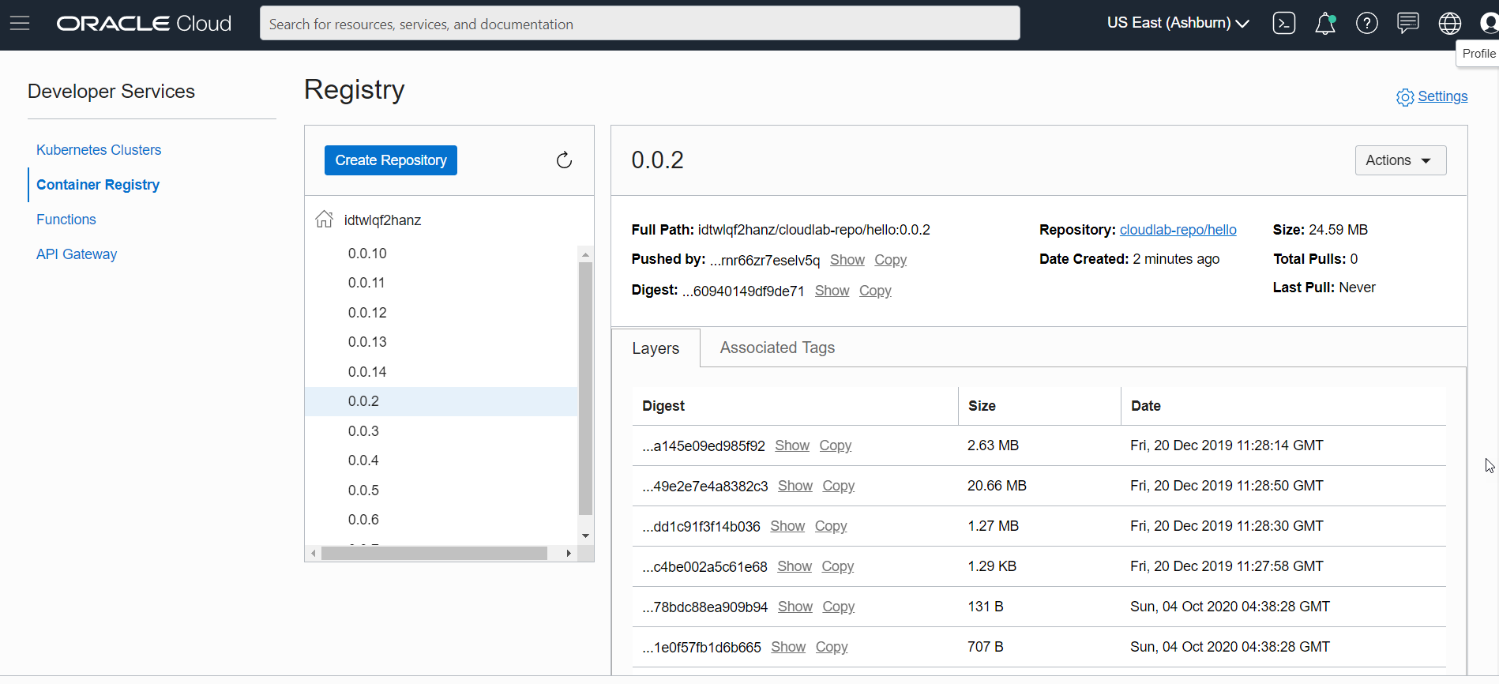
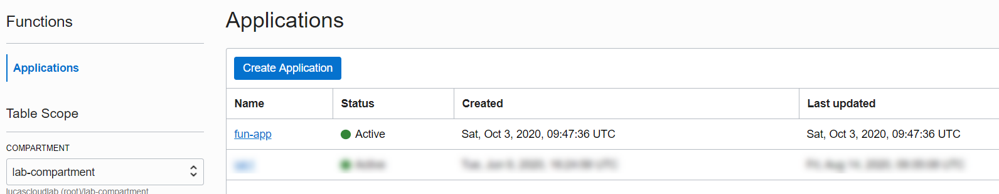
Demo Your First Function – on OCI
Application
Functions

Slide 21
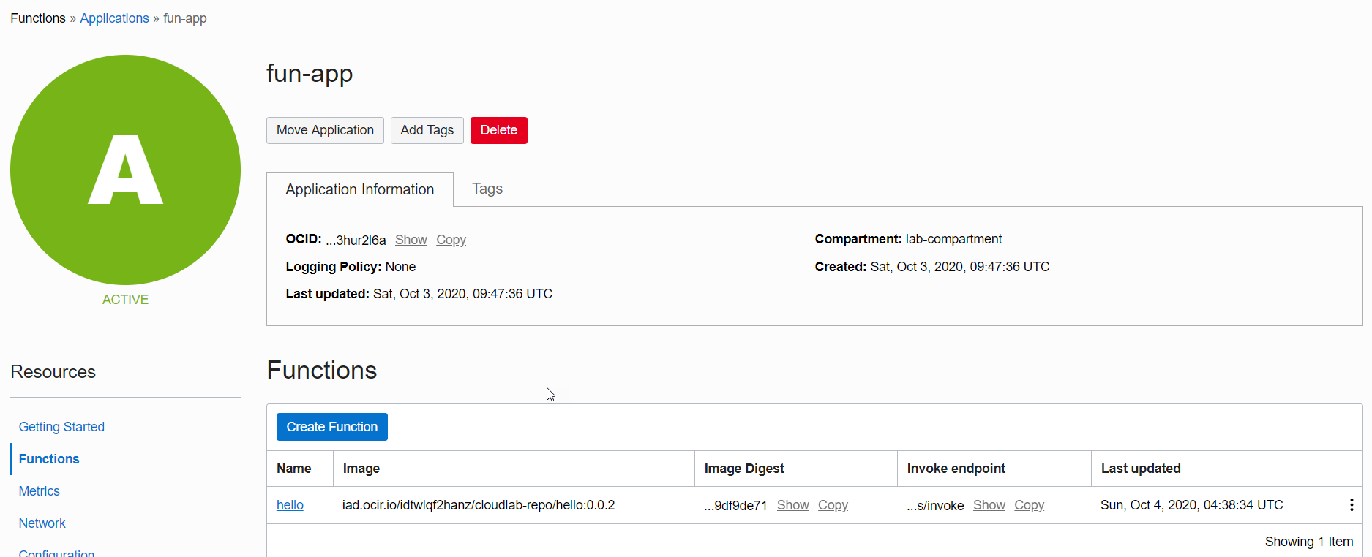
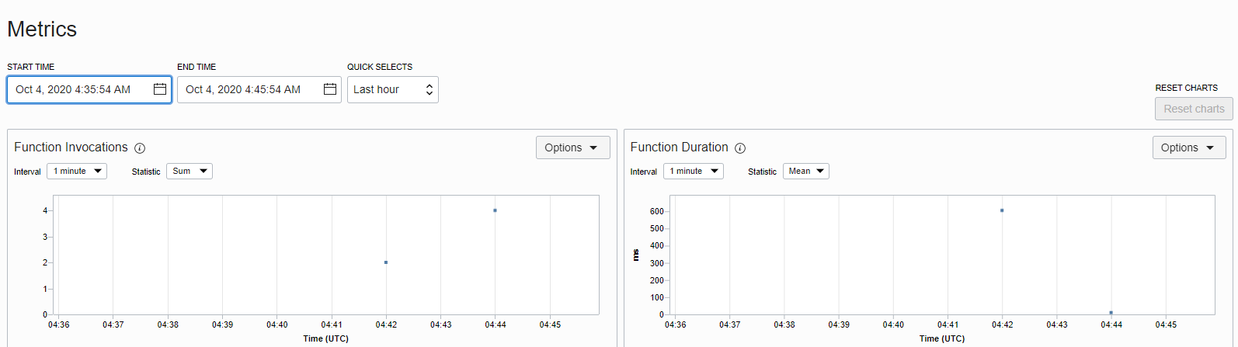
Demo Your First Function – on OCI

Slide 22



Logical Grouping on OCI to work with Functions
TENANCY
COMPARTMENT
Groups
VCN
SUBNET
Application
Application
Policies
Functions
Functions
Container Registry

Slide 23
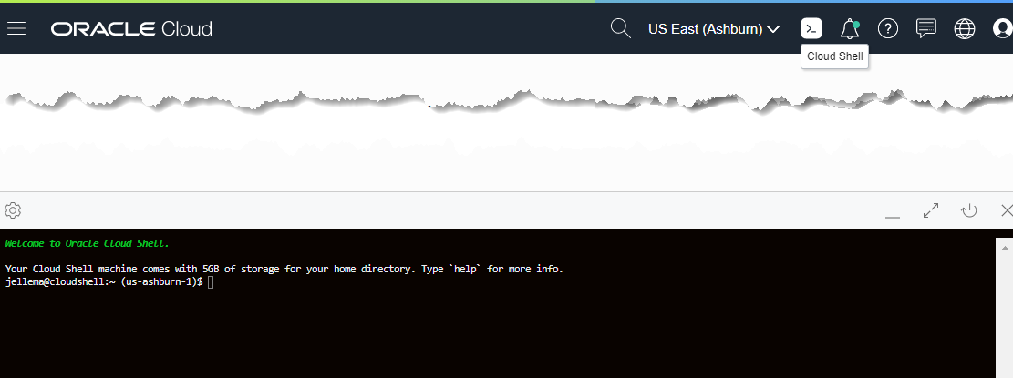

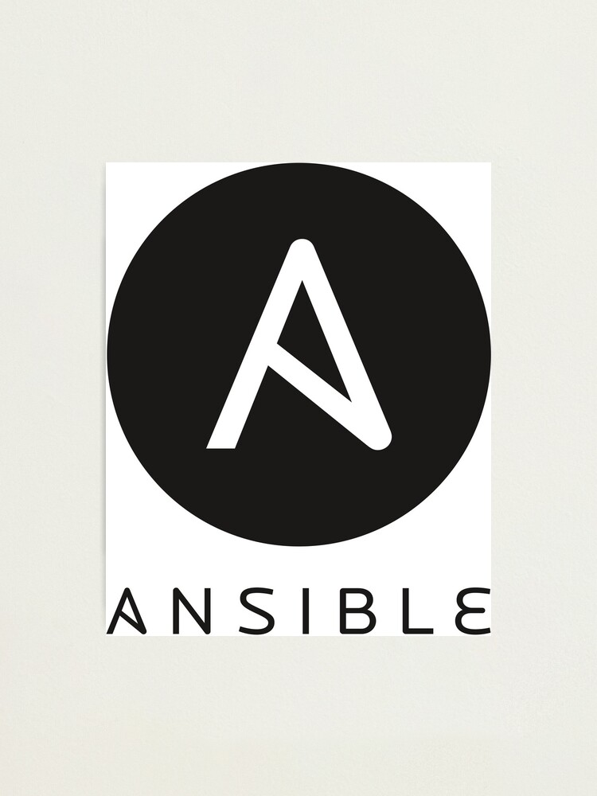





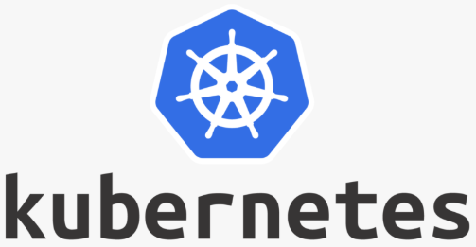







Cloud Shell
OCI Cloud Tenancy

Slide 24
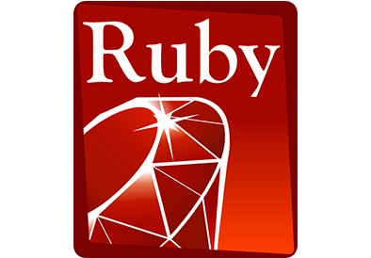
Mental Picture: Stateless and Serverless
FDK
Oracle Groundbreakers Tour 2020 EMEA | Make your Cloud Applications Function for real

Slide 25

Mental Picture: Stateless and Serverless “execution engine”
Configuration Parameters
FDK

Slide 26

Mental Picture: Build Process
Container Image Registry
function.yaml
FDK
push
FDK
Operating System
Language Runtime
go, java8, java9, java, java11, node, python, python3.6, python, python3.7, ruby, and kotlin
Notes:
Additional settings: max time to run (<= 120 seconds)
Note: size of local file system is related to memory shape (32, 64, 128, 256MB) as is the number of files

Slide 27
Mental Picture: Build & Deploy Process
Container Image Registry
Deploy Function Application
Associated with Network & Compartment
Specify max time to run and memory shape (128, 256, 512, 1024 MB) for function in function.yaml
function.yaml
FDK
push
Oracle Functions on OCI
FDK
Operating System
Language Runtime
Notes:
Additional settings: max time to run (<= 120 seconds)
Note: size of local file system is related to memory shape (32, 64, 128, 256MB) as is the number of files

Slide 28
Mental Picture and Actual Runtime
128 | 256 | 512 | 1024 MB Memory, 32 | 64 | 128 | 256 MB File System
File system can be read, /tmp can be written to
Configuration Parameters available as Environment Variables
Container Image Registry
Configuration Parameters
Oracle Functions on OCI
Container Orchestrator
Serverless
Memory Shape, Max Time to Run, Configuration Parameters
VM
Server
Notes:
Additional settings: max time to run (<= 120 seconds)
Note: size of local file system is related to memory shape (32, 64, 128, 256MB) as is the number of files

Slide 29
Mental Picture and Actual Runtime
Container is kept running for 10-15 minutes – primed (hot) for handling more requests.
It is removed when it has been idle for that time.
It retains global state and file system contents during its lifetime. Note: hold on to and reuse expensive connections
Container Image Registry
Configuration Parameters
Oracle Functions on OCI
Container Orchestrator
Stateless
VM
Server
Logging
Monitoring
Auditing
Notes:
Additional settings: max time to run (<= 120 seconds)
Note: size of local file system is related to memory shape (32, 64, 128, 256MB) as is the number of files

Slide 30
Mental Picture and Actual Runtime
Container Image Registry
Oracle Functions on OCI
Container Orchestrator
VM
Server
Logging
Monitoring
Auditing
Notes:
Additional settings: max time to run (<= 120 seconds)
Note: size of local file system is related to memory shape (32, 64, 128, 256MB) as is the number of files

Slide 31
Mental Picture and Actual Runtime
Container Image Registry
Oracle Functions on OCI
Container Orchestrator
VM
Server
Logging
Monitoring
Auditing
Notes:
Additional settings: max time to run (<= 120 seconds)
Note: size of local file system is related to memory shape (32, 64, 128, 256MB) as is the number of files

Slide 32
Mental Picture and Actual Runtime
Oracle Functions starts multiple Docker containers, up to the limit specified for your tenancy. The default limit is 30 GB of RAM reserved for function execution per availability domain
Container Image Registry
Container Orchestrator
VM B
Server 2
Oracle Functions on OCI
Container Orchestrator
VM A
Server 1
Logging
Monitoring
Auditing
Notes:
Additional settings: max time to run (<= 120 seconds)
Note: size of local file system is related to memory shape (32, 64, 128, 256MB) as is the number of files

Slide 33
Mental picture vs Physical reality
Stateless? One execution per instance? Serverless?
Explore
Cross execution state (memory)
Multiple concurrent requests
Lifetime of an instance
Container details
Function with
Request counter (as cross execution state)
Concurrent requests counter (and multi second delay)
Write ‘still alive’ log messages
Get host details (from Fn context)
requestCounter
concurrentRequests
lifetimeOfInstance
console.log()
process.on(‘exit’,…)
Notes:
https://stackoverflow.com/questions/14031763/doing-a-cleanup-action-just-before-node-js-exits
function sleep(ms) { return new Promise(resolve => setTimeout(resolve, ms)); }
async function delayedGreeting() { console.log("Hello");
await sleep(2000); console.log("World!");
}

Slide 34
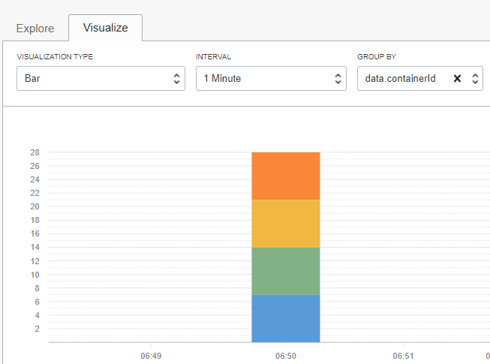

Physical Function Findings
No concurrent request handling in a single instance
Four concurrent requests, four different hosts (== container instances)
Each instance handles multiple [subsequent] requests
State is kept in instance between requests
Until the death of an instance
An instance can perform some background work after a request is responded to (13 seconds?)
Part of pay per use?
An instance is killed after [approximately] 10 minutes
Notes:
https://technology.amis.nl/2020/01/12/somewhat-stateful-serverless-functions-on-oracle-cloud-infrastructure-implementing-a-diy-cache/

Slide 35
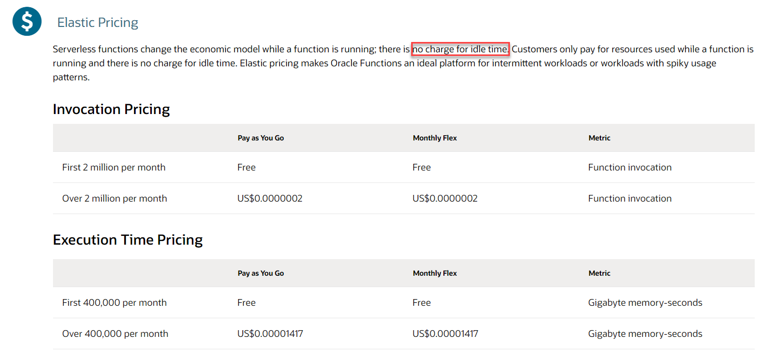
Pricing Oracle Functions – no use, no pay (and even if quite a bit of use – then still no pay)
free tier = 106K executions per day (assuming 128MB shape and 1 second execution time)
Notes:
($1.5 per 100,000 GB Memory-Seconds, plus $0.02 per 100K invocations).
assuming 128MB shape for function, and 1 second execution time (which is fairly long) 400K GB/s per month = 106K executions per day

Slide 36


Functions vs Containers vs VMs
Functions
Containers on OKE
VMs
Functions
Serverless
No IaaS DevOpS
Stepless Pay per use
Free-Tier
Auto-Scale
Automatic Fail Over
Integration with OCI
Triggered by OCI
Call OCI services
Leverage OCI for Audit, Log, Monitor
Restricted, simple programming model
Short running
Container Engine
For Kubernetes
Serverless runtime
Initial IaaS Setup
Pay per VM, scale per VM
Auto-Scale by K8S
Some auto Fail Over
Little integration with OCI
Kubernetes for Ops
Flexible programming model – any container goes
Virtual Machine
Fully Servered
DIY IaaS Op
Pay per VM, scale per VM, cheap at large scale
Manual Scaling
Manual Fail Over
Little integration with OCI
Flexible programming model

Slide 37

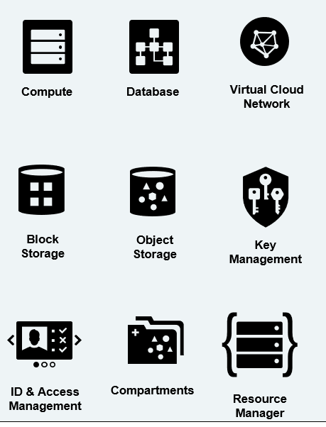



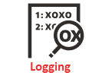

Function execution is triggered by
Any HTTP request
Authenticated, Signed HTTP request
API Gateway
Healthcheck
Functions
Events
Notifications
Alarming
Resource
Manager
Service Connector

Slide 38
Function execution is triggered by
Ops automation
App
Any HTTP request
Authenticated, Signed HTTP request
Application
App
Ops
API Gateway
Healthcheck
Ops
Functions
Events
App
Ops
Ops
Notifications
Ops
Alarming
Ops
Resource
Manager
Service Connector

Slide 39
API Gateway
Expose private endpoints publicly
Stable (public) endpoints
Routing (verb & wildcard based)
Parameter and Header mapping
Request Policies
Rate limiting (per client & general)
CORS (for direct web client access)
Metrics Monitoring & Logging
Authentication & Validation
Transform headers & parameters in requests & headers in responses
Handle HTTP calls:
Authorize
Route
Map
Transform
Observer
Monitor
Audit
Log
Function
Any Service Invoker
API Gateway
Stock
API Gateway
Any 3rd party HTTP endpoint
VM
Any HTTP Endpoint on OCI
OKE
OIC
…
Logging
Monitoring
Auditing
Oracle Cloud Infrastructure

Slide 40
API Gateway Authorizer Function
Authorizer Function can be configured on Route or on API Deployment
Any backend – HTTP destination, Oracle Function, Stock Response – can be subject to an authorizer function
Invoke API, provide token in header
JSON returned by Authorizer Function is embedded in request to backend
Any Service Invoker
API deployment
/path
Any backend
API Gateway
API Gateway
API Gateway
Authorizer Function
Authorizer Function that allows or denies access based on Header [Token]
Oracle Cloud Infrastructure

Slide 41
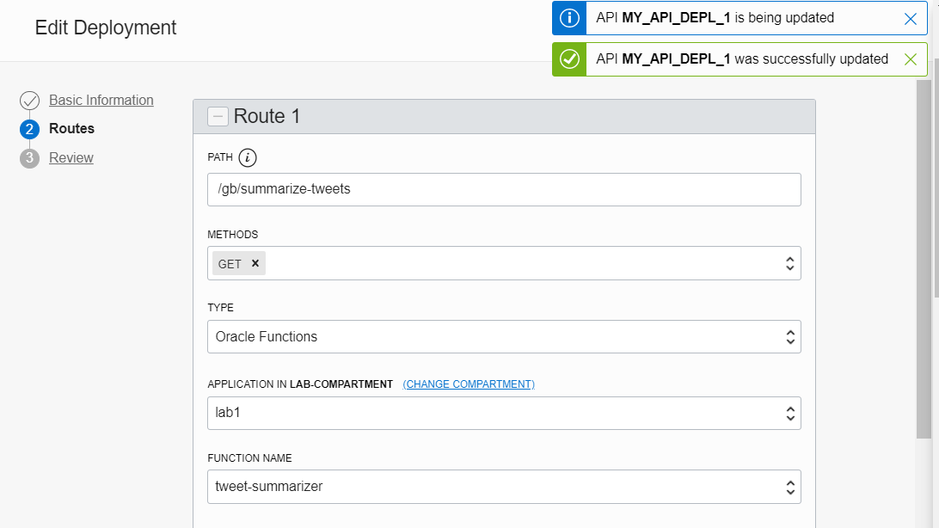
API Gateway Configuration for public access to Function

Slide 42
Leverage OCI PaaS Services and Facilities from Functions
Streaming
synchronous
NoSQL Database
API Gateway
Object Storage
Functions
asynchronous
Autonomous Database
Notifications
Email Delivery
Autonomous JSON
Logging
Monitoring
Auditing
Vault

Slide 43
Allow Functions to Invoke OCI APIs through Resource Principal authorization
Any OCI API call must be authenticated (signed) and authorized
(Human) users can be granted permissions and can sign requests
A function can be a resource principal – that is granted permissions (via Dynamic Group) and gets an auto-generated key-file injected used for signing
Function
Object Storage

Slide 44
Allow Functions to Invoke OCI APIs through Resource Principal authorization
Any OCI API call must be authenticated (signed) and authorized
(Human) users can be granted permissions and can sign requests
A function can be a resource principal – that is granted permissions (via Dynamic Group) and gets an auto-generated key-file injected used for signing
Policy
Resource
pem
rpst
Function
Dynamic group
Object Storage
Rule

Slide 45

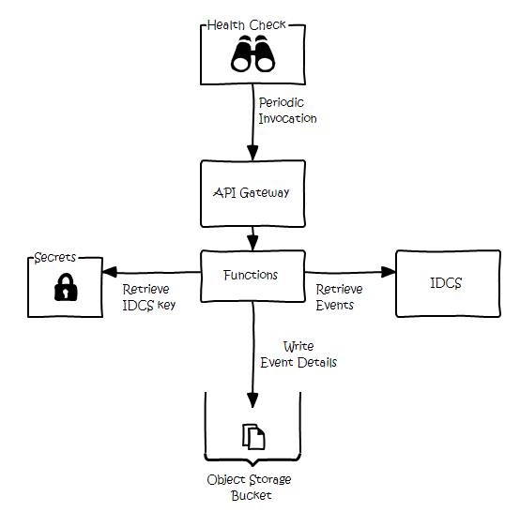
Implement OCI Operations Task using Functions
Requirement: longer term retention of audit events for several different reasons, including governance, compliance and forensic requirements
Audit events comprise: Audit Service recording administrative operations and Oracle Identity Cloud Service (IDCS) tracking access and user management events
Approach: periodic extraction of security event details from OCI services and storing on OCI Object Storage
source: https://redthunder.blog/2020/10/02/simple-secure-log-retention-using-oci-services/
Notes:
https://redthunder.blog/2020/10/02/simple-secure-log-retention-using-oci-services/
https://github.com/CallanHP/idcs-log-to-obj-store

Slide 46






Functions in Cloud Native Application on OCI: Tweets to NoSQL, Streaming & Email
Function
Object Storage
Function
Events
Notifications
NoSQL Database
API Gateway
Healthcheck
Streaming
#groundbreakerstour

Slide 47


Tweets to NoSQL, Streaming & Email
Store JSON file with all tweets in time period
Cloud Event for new JSON file
Create Tweet Records in NoSQL
Trigger function with event
NoSQL Database
Invoke Tweet Aggregator every X minutes
Function
Publish to Notification Topic
Expose function to external callers
Object Storage
Write JSON document with Tweets
API Gateway
Streaming
Healthcheck
Events
Publish each Tweet to Stream
Function
Retrieve X minutes worth of tweets
Notifications
Send Tweet Report as email
Get Twitter credentials in secure way from vault
Vault
Logging
OCIR
Monitoring
Compartments
#groundbreakerstour
API/Service

Slide 48

Functions facilitate Decoupling
Encapsulation (of implementation)
Run time availability independence
Independent release / reconfigure
Independence of scaling
Volume Load Throttling/Absorption
Security Boundary
Failure isolation
NoSQL Database
Function
Object Storage
API Gateway
Streaming
Function
Events
Notification Topic
Vault
Logging
OCIR
Monitoring
Compartments
#groundbreakerstour
API/Service

Slide 49
Automated Test of Functions
Unit Test to verify the behavior of the code
Implement functionality apart from FDK
Mock external services
http
Mock FDK
FDK
Automated Test using your favorite language specific framework, such as JUnit 5, Jest, pytest, …

Slide 50
Types of Tests
ISOLATION
more
less
Unit Test
isolated
sociable/ wired
Integration Test
Static Code Analysis
End to End Test
Smoke Test/Health Check/ Chaos Test

Slide 51
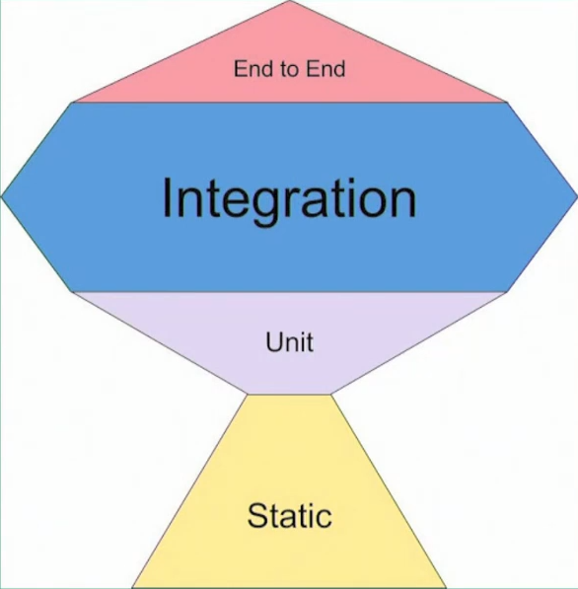
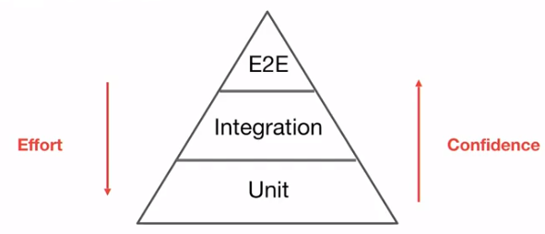
Types of Tests
ISOLATION
more
less
More:
Speed
Tests
Boundary Testing
Non-happy flows & corner cases
Mocks
Maintenance
Refactoring Protection
Technical
More:
Functional / Specification driven
Confidence
Bugs caught
Contract & Interaction
REAL (mocks poke holes in reality)
Side effect
Effort (per test)
Execution time
Unit and (most of) its internal dependencies; external dependenices are mocked
Unit Test
isolated
sociable/ wired
Integration Test
single unit, all dependencies are mocked
(aka Integration or BroadStack) test: tests include (unmocked) external dependencies; parts of the system can still be mocked
When used at runtime – E2E tests function as Smoke Test/Health Check – to test health of interactions at PaaS & IaaS level
Static Code Analysis
End to End Test
Verify code quality guideline adherence – without running any code
Some external dependencies are mocked; all internal units are used unmocked
Tests in full blown environment (ACC, PROD); focus on (continuous) health – end to end availability of connections, permissions, platform and infra components; focus on important functional flows
Smoke Test/Health Check/ Chaos Test

Slide 52
Other Types and Scopes of Tests
Integration Test
Only mocks at the far ends of the chains
Smoke Test/Health Check
Live environment, no mocks
Live test data set (with no business side effects)
Smoketest
API Gateway
Functions

Slide 53

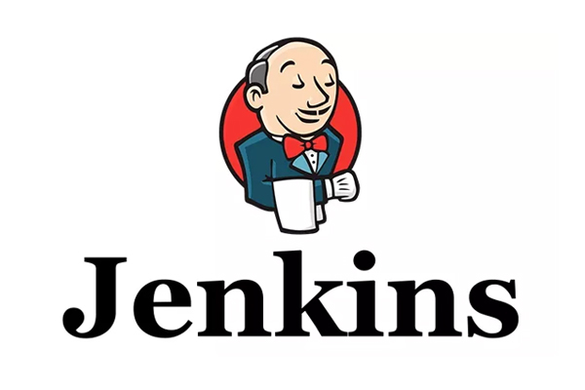



CI/CD – from Dev through build, package, release, deploy to Ops
Resource
Manager
Application
Continuous Integration
CLI
CLI
Continuous Delivery
Deployment
Oracle Functions on OCI
Functions
Container Registry

Slide 54
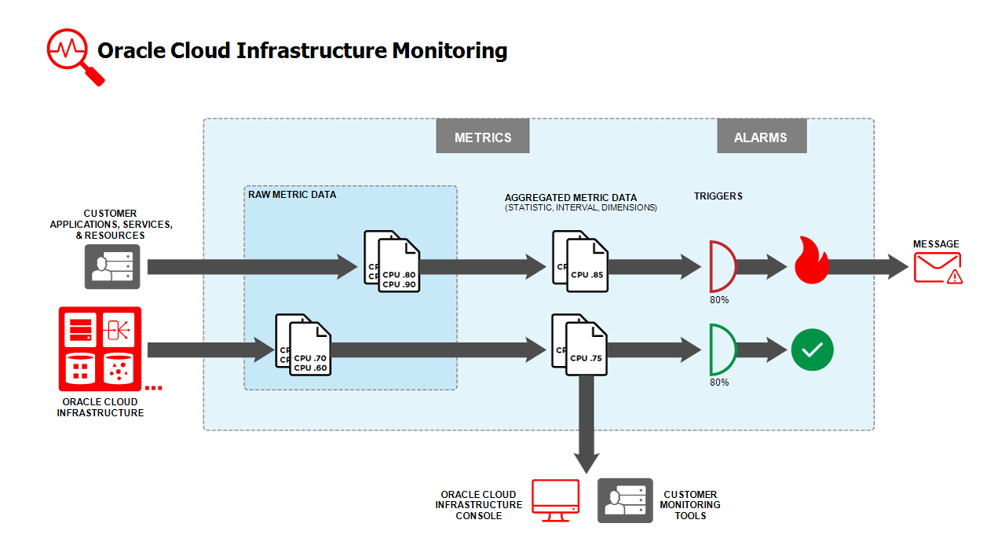
DevOps on Functions
Monitoring
Metrics on Number | Duration | Status of Function calls - per time window
Alarms on special conditions – causing notifications to be sent
Logging
Application Logging from Function is captured by OCI Logging Service and can be explored and processed
Auditing
Management activities regarding functions are captured by Audit Service (who, when, what, with which function)
Application Configuration Settings
By (re)defining Configuration Settings on application or function can the run time behavior of the function be influenced
Functions
Logging
Monitoring
Auditing

Slide 55
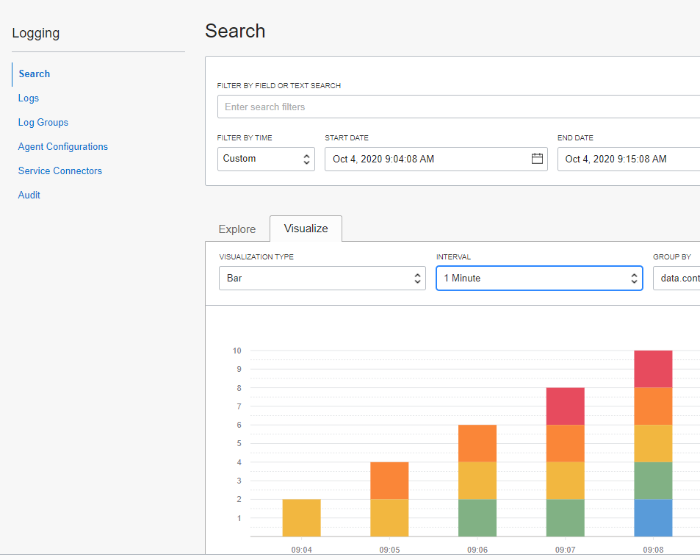
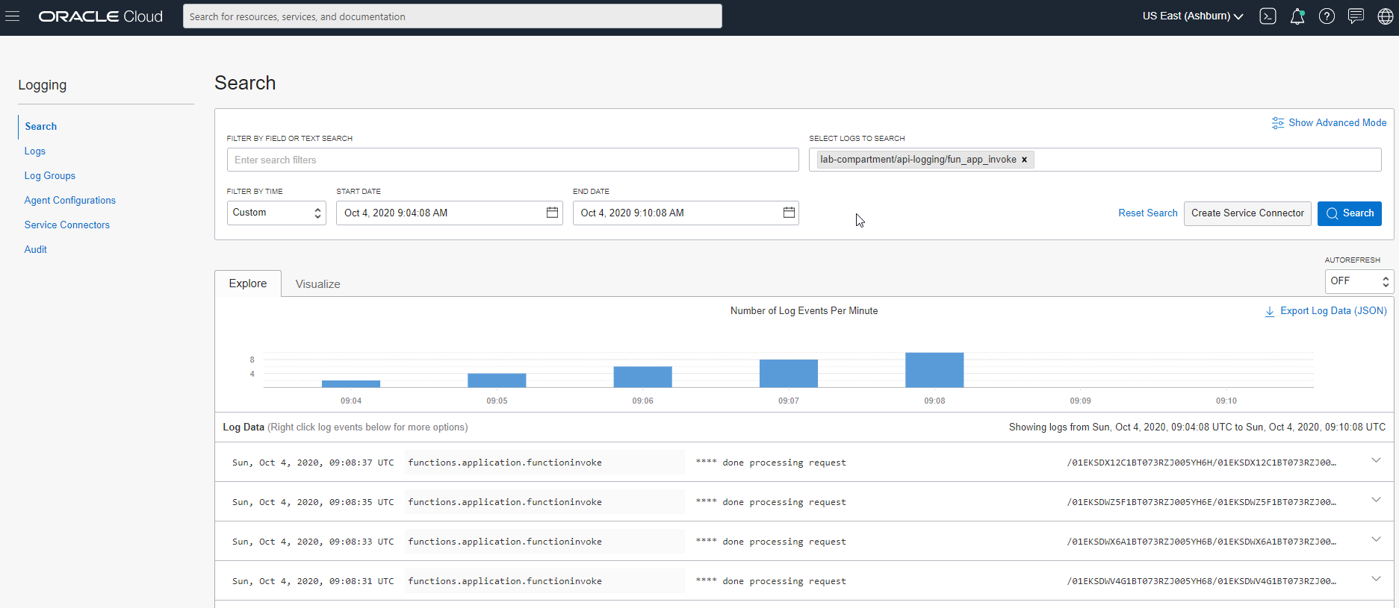
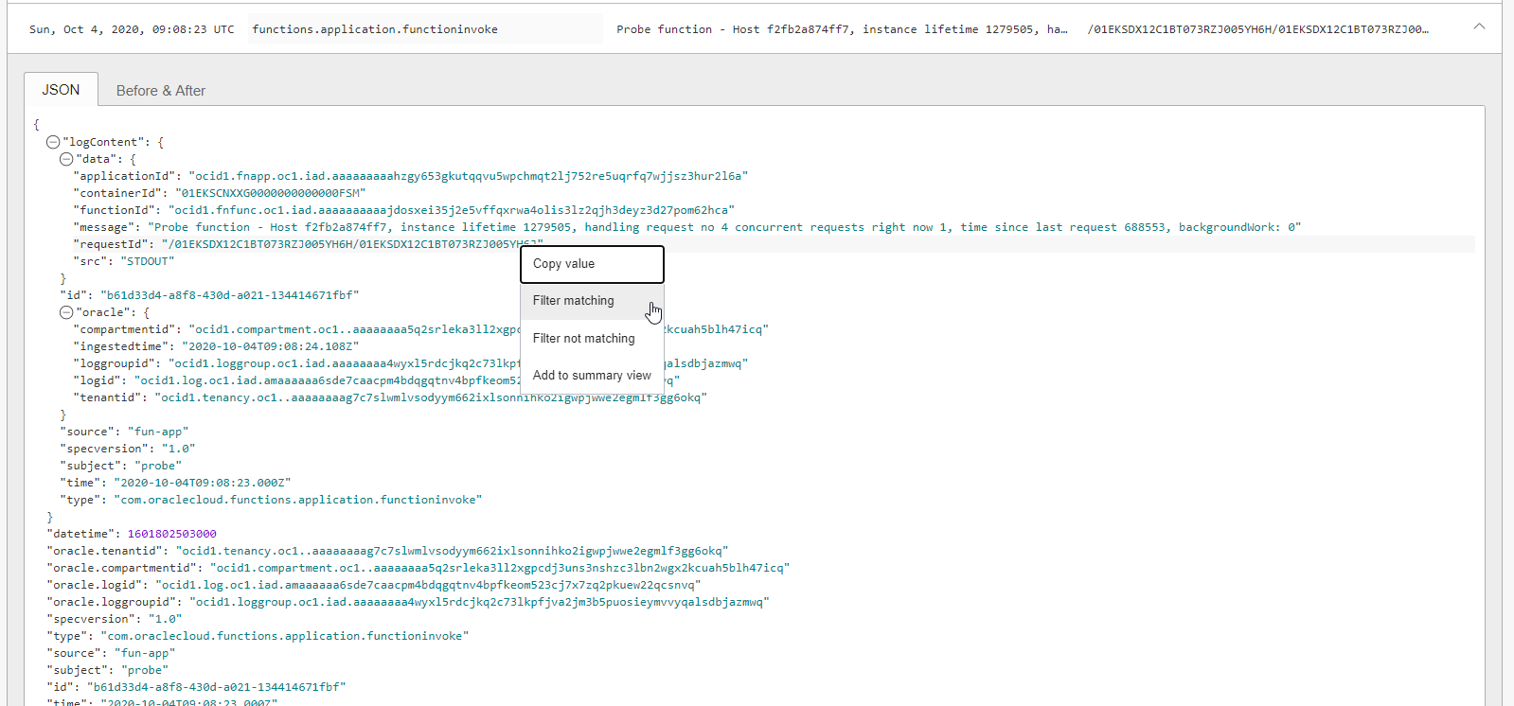
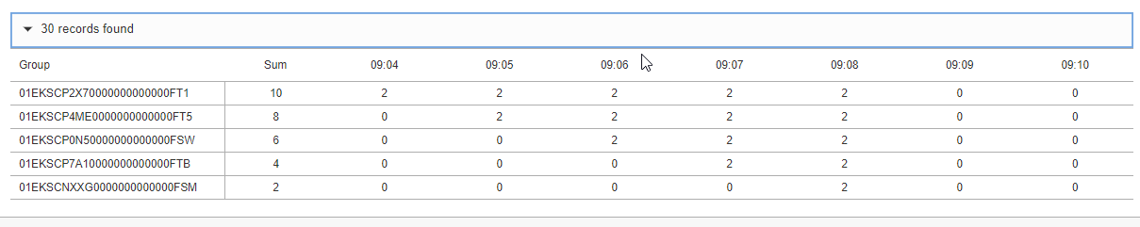
Logging

Slide 56
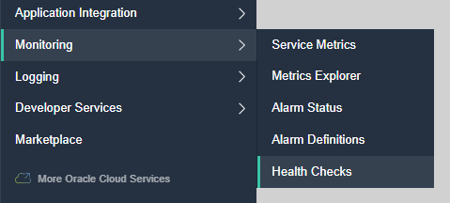


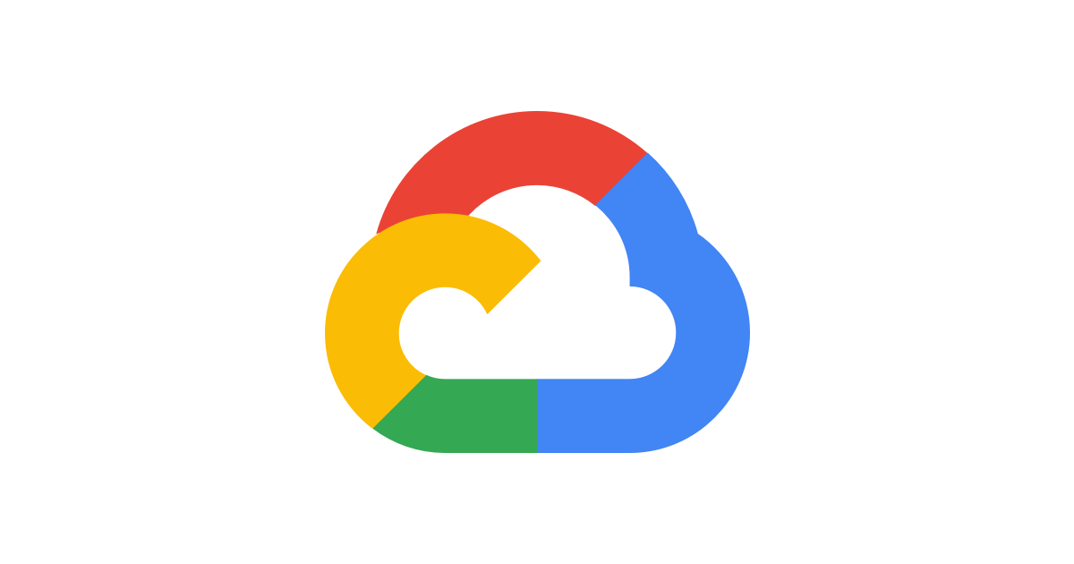


Monitoring | Health Checks
Verify through the eyes of an external client if endpoints are available and respond quick and well
Periodic or Adhoc call to an endpoint
HTTP(S) or Ping
Specify Headers
Specify Interval (check frequency)
From selected Vantage Points
3rd party clouds, geographic locations around the world
Health Check results can be inspected through the Monitor in the Console
Use health checks for live function smoke tests
API Gateway
Functions
Healthcheck

Slide 57
[tricks for] Scheduling Functions
OCI does not currently have a way to schedule jobs
Health Checks are scheduled, periodic HTTP(S) requests
Once every 30 | 60 seconds or 5 | 10 | 15 minutes
Monitoring Alarms are evaluated and repeated on the indicated specific interval
Define an Alarm that will be triggered; set repeat interval at desired function execution interval
Monitoring
Alarming
API Gateway
Functions
Notifications
Healthcheck
CRON expression passed as header or parameter in healthcheck configuration
Configuration Parameters
When triggered evaluate CRON expression and decide whether to run
CRON expression to run once every hour | day | Sunday | …

Slide 58
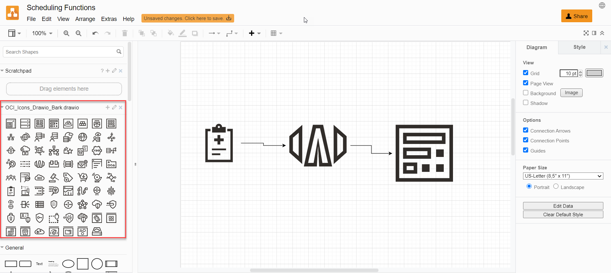
Drawing OCI Solution Designs on draw.io
Download draw.io graphics from https://docs.cloud.oracle.com/en-us/iaas/Content/General/Reference/graphicsfordiagrams.htm… , unzip and upload as library to draw.io

Slide 59

Oracle Functions - Points for improvement
Function to Function invocation could be much simpler
Simple Fn SDK call instead of complex OCI API call
Automatic tracing of function calls
Asynchronous mechanism for function triggering
OCI Streaming does not trigger function execution
OCI Notification Topics are capped at 60 messages per minute
OCI API Gateway only handles synchronous requests – not fire & forget
Function orchestration or coordination
Workflow, parallel execution, transaction handling (Saga pattern)
Project Fn is showing hardly any activity on GitHub
Is it alive? Does it have a future?

Slide 60
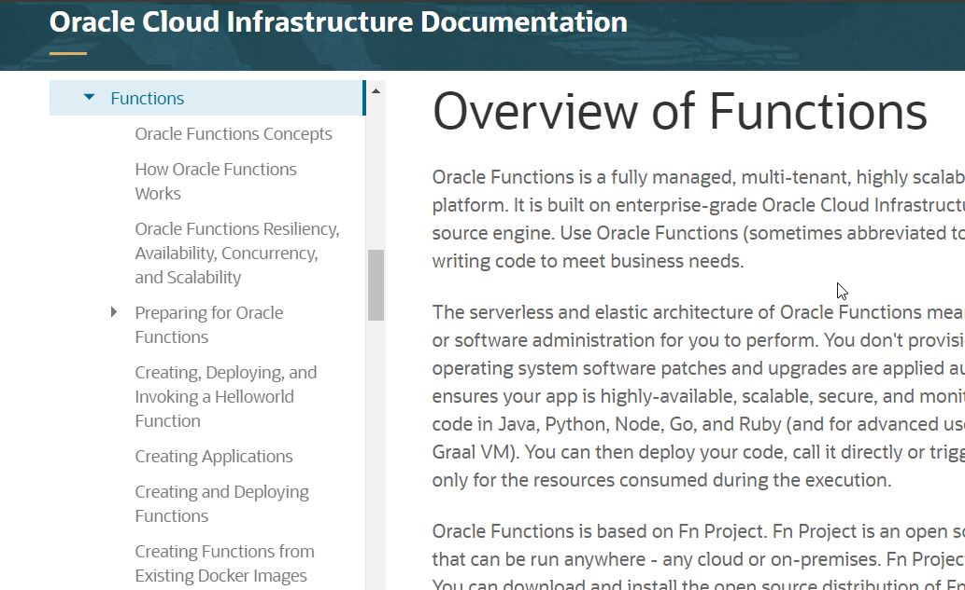
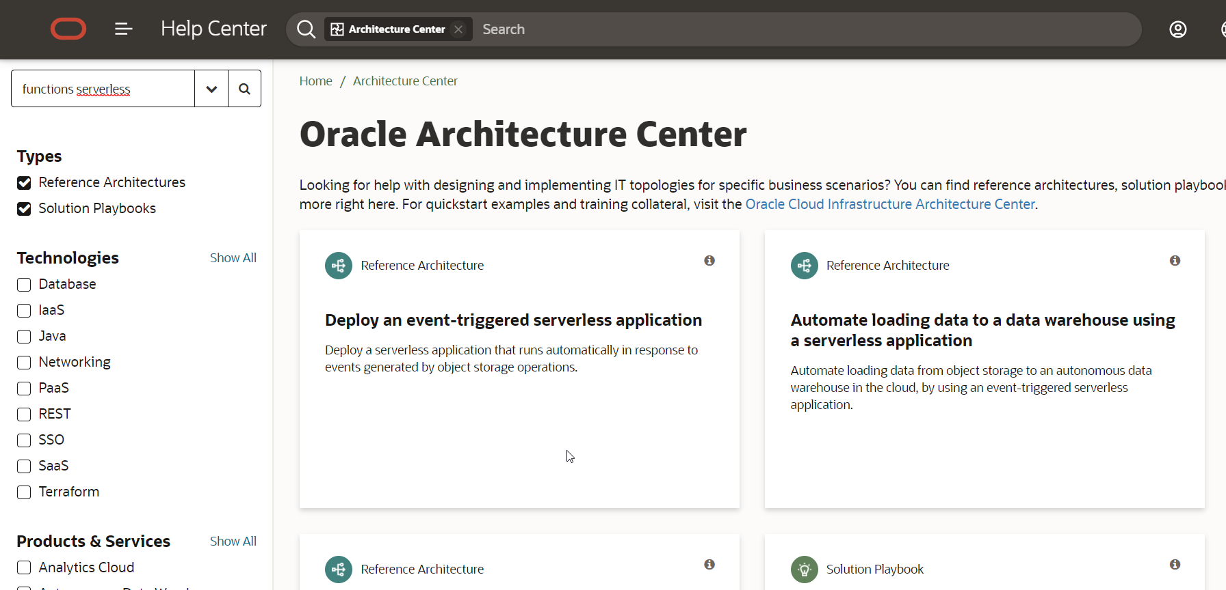
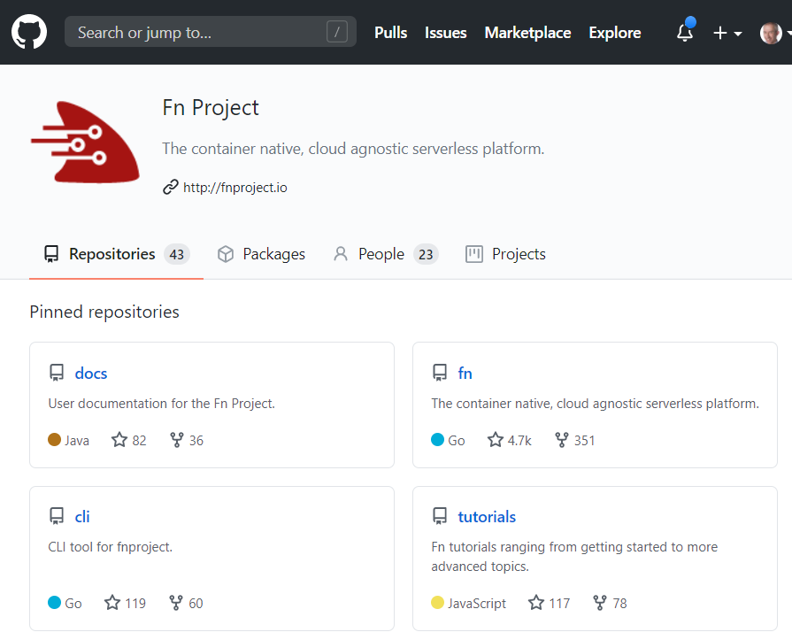
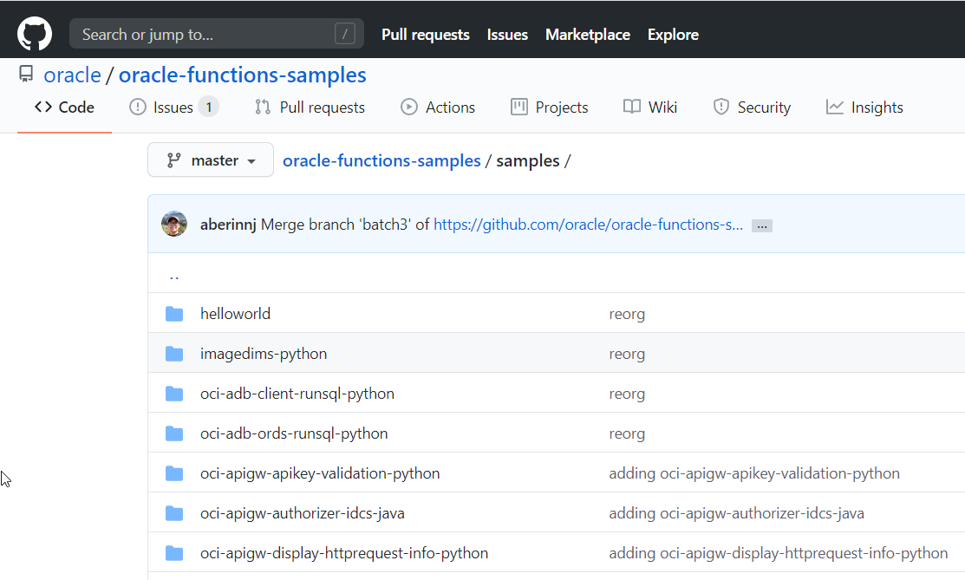
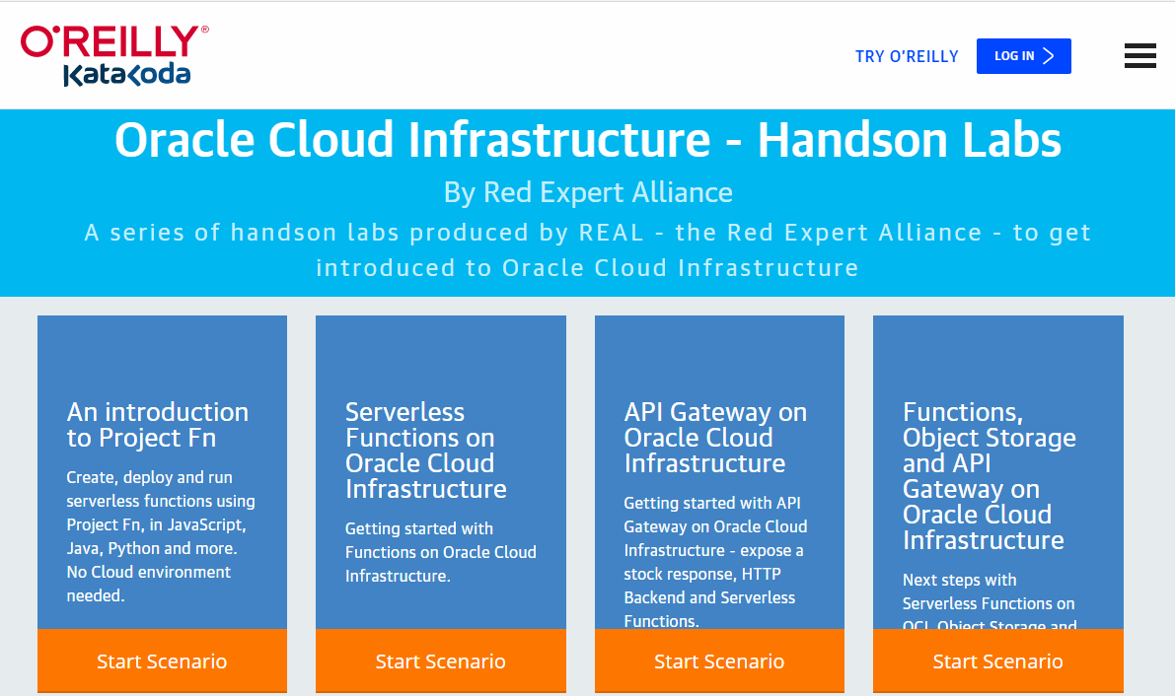
Get going with Functions on OCI
katacoda.com/redexpertalliance/courses/oci-course

Slide 61

Functions are crucial part and great example of cloud native
Cloud Native: Platform Services
Managed
Quick Provision & Decommission
Distributed
Automated
Pay per use/TCO
Vendor takes runtime responsibility
Enterprise grade platform for all Security & Availability
Scale
Ops facilities (monitor, log, failover)
Rapid Innovation (new services, new features, new pricing)
Functions
Serverless in all the good ways
Simple and cheap
Freedom of implementation – little lockin
Rapid start
Easy to get started with
Native fit with OCI
Leverage FaaS, invoke and triggered by PaaS, automated Ops (OCI worker bees)

Slide 62
Thank you for your attention I hope this was useful
Sources and slides: http://bit.ly/function-for-real-ogbemea2020
lucas.jellema@amis.nl | technology.amis.nl | @lucasjellema | lucas-jellema

